Slide 1
Lecture 17 Confidence Intervals

Slide 2
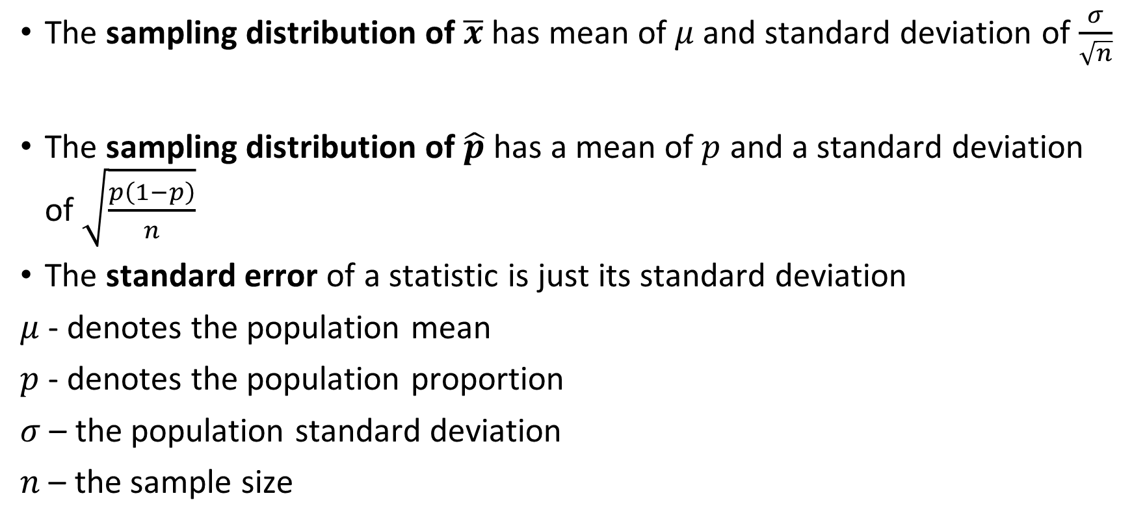
Review:
The sampling distribution of $\overline{x}$ has mean of $μ$ and standard deviation of $\frac{σ}{\sqrt{n}}$
The sampling distribution of $\hat{p}$ has a mean of $p$ and a standard deviation of $\sqrt{\frac{p\left(1−p\right)}{n}}$
The standard error of a statistic is just its standard deviation
$μ$ - denotes the population mean
$p$ - denotes the population proportion
$σ$ – the population standard deviation
$n$ – the sample size

Slide 3
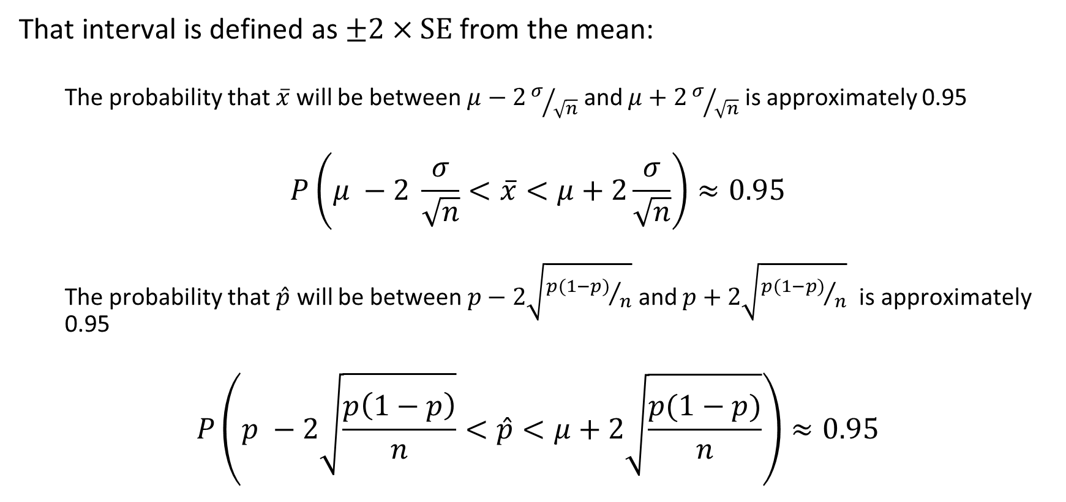
Review 2
That interval is defined as $±2×SE$ from the mean:
The probability that $\overline{x}$ will be between $μ−2σ/{\sqrt{n}}$ and $μ+2σ/{\sqrt{n}}$ is approximately 0.95
$$P\left(μ −2 \frac{σ}{\sqrt{n}}<\overline{x}<μ+2\frac{σ}{\sqrt{n}}\right)≈0.95$$
The probability that $\hat{p}$ will be between $p−2\sqrt{{p(1−p)}/n}$ and $p+2\sqrt{{p(1−p)}/n}$ is approximately 0.95
$$P\left(p −2\sqrt{\frac{p\left(1−p\right)}{n}}<\hat{p}<μ+2\sqrt{\frac{p(1−p)}{n}}\right)≈0.95$$

Slide 4
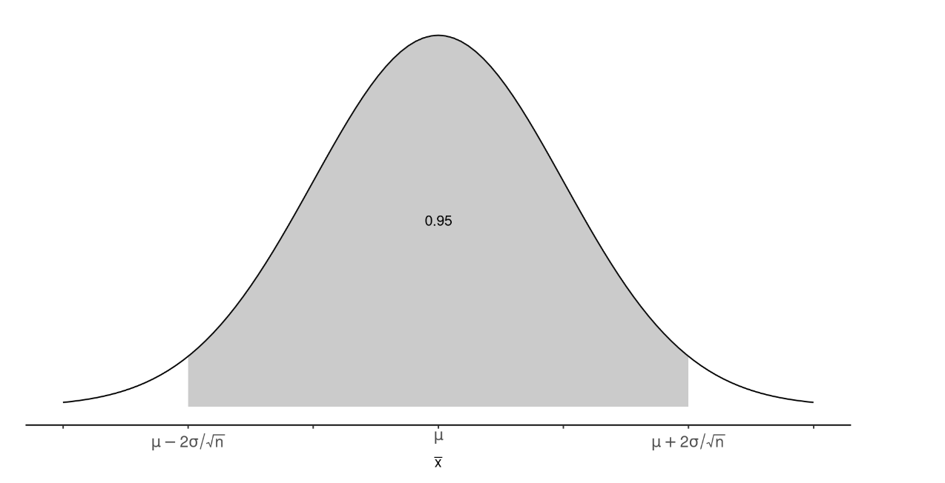

Slide 5
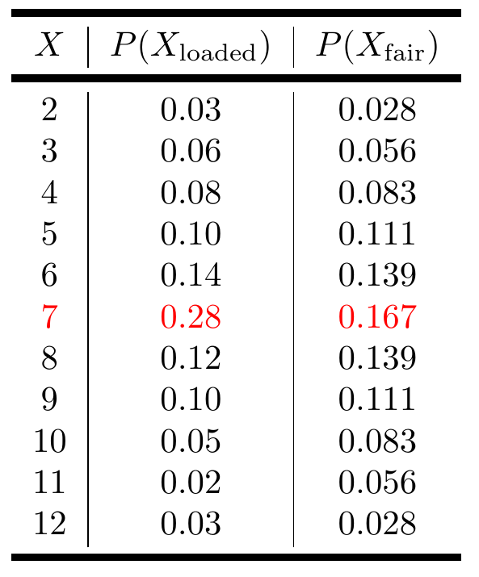
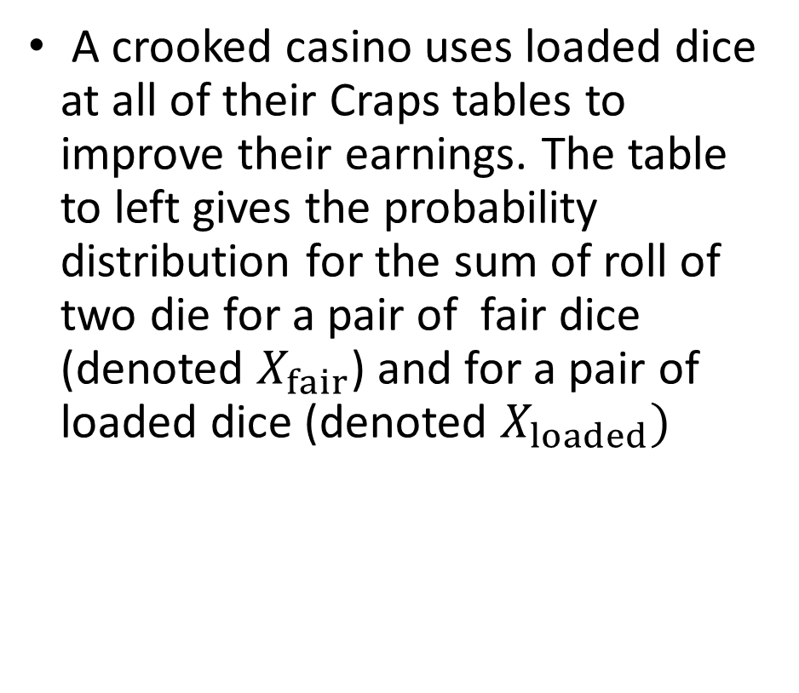
Practice: Crooked Casino
A crooked casino uses loaded dice at all of their Craps tables to improve their earnings. The table to left gives the probability distribution for the sum of roll of two die for a pair of fair dice (denoted $X_{fair}$) and for a pair of loaded dice (denoted $X_{loaded})$

Slide 6
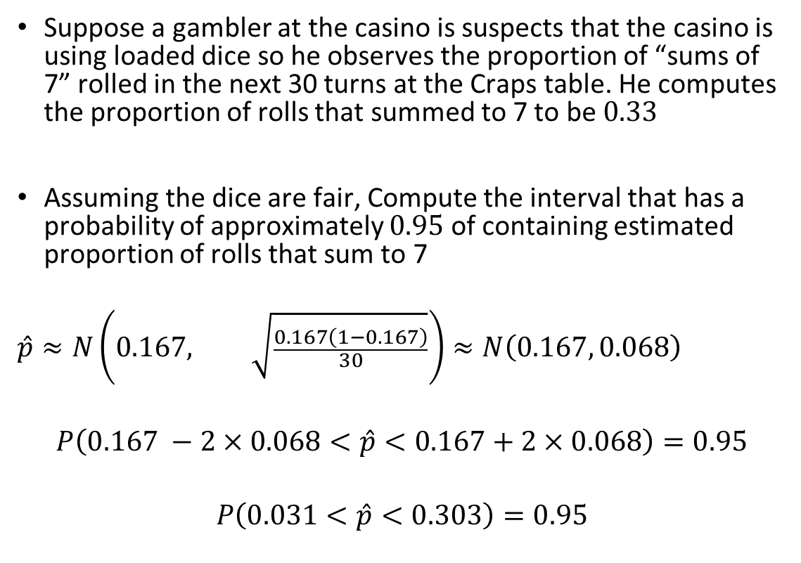
Practice: Crooked Casino
Suppose a gambler at the casino is suspects that the casino is using loaded dice so he observes the proportion of “sums of 7” rolled in the next 30 turns at the Craps table. He computes the proportion of rolls that summed to 7 to be $0.33$
Assuming the dice are fair, Compute the interval that has a probability of approximately $0.95$ of containing estimated proportion of rolls that sum to 7
$$\hat{p}≈N\left(0.167, \sqrt{\frac{0.167\left(1−0.167\right)}{30}}\right)≈N\left(0.167, 0.068\right)$$
$$P\left(0.167 −2×0.068<\hat{p}<0.167+2×0.068\right)=0.95$$
$$P\left(0.031<\hat{p}<0.303\right)=0.95$$

Slide 7
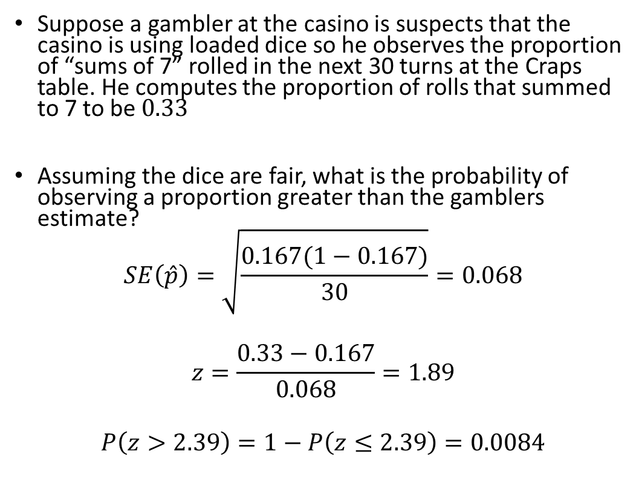
Practice: Crooked Casino
Suppose a gambler at the casino is suspects that the casino is using loaded dice so he observes the proportion of “sums of 7” rolled in the next 30 turns at the Craps table. He computes the proportion of rolls that summed to 7 to be $0.33$
Assuming the dice are fair, what is the probability of observing a proportion greater than the gamblers estimate?
$$SE\left(\hat{p}\right)=\sqrt{\frac{0.167(1−0.167)}{30}}=0.068$$
$$z=\frac{0.33−0.167}{0.068}=1.89$$
$$P\left(z>2.39\right)=1−P\left(z≤2.39\right)=0.0084$$

Slide 8
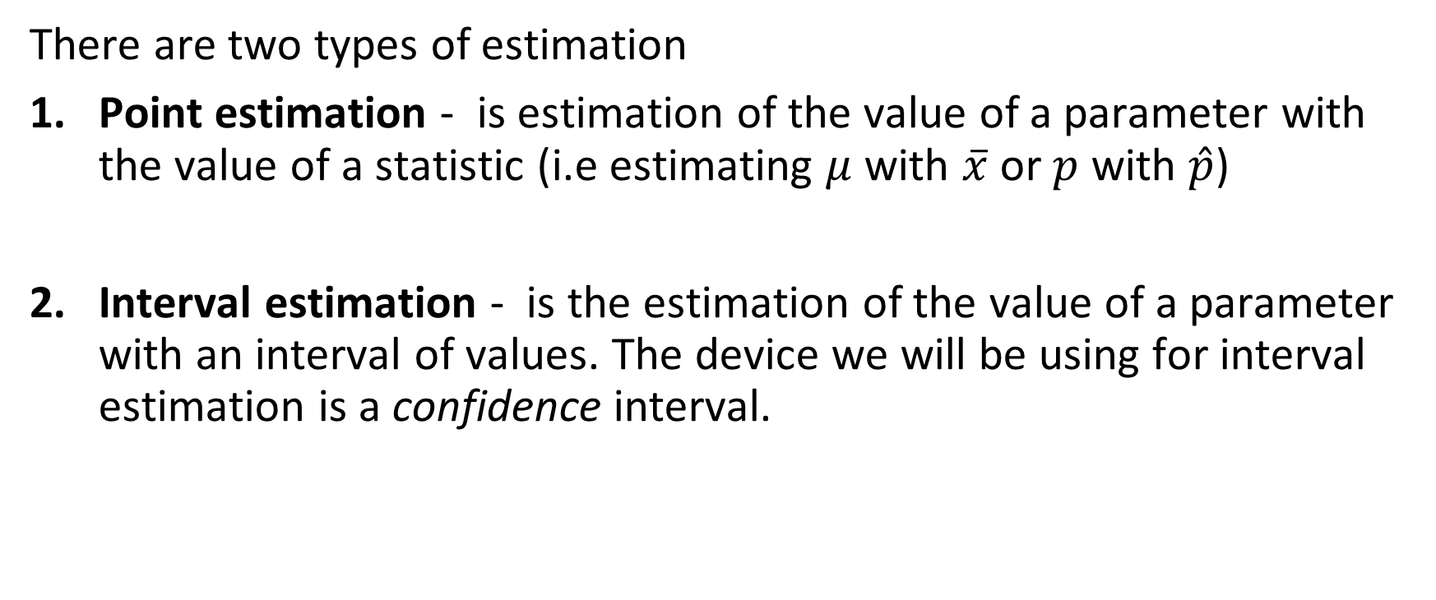
Types of Estimation
There are two types of estimation
Point estimation - is estimation of the value of a parameter with the value of a statistic (i.e estimating $μ$ with $\overline{x}$ or $p$ with $\hat{p}$)
Interval estimation - is the estimation of the value of a parameter with an interval of values. The device we will be using for interval estimation is a confidence interval.

Slide 9
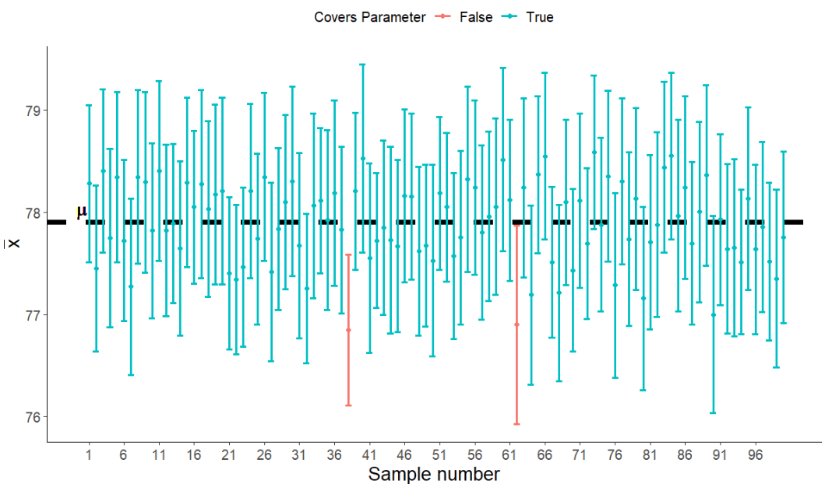

Slide 10
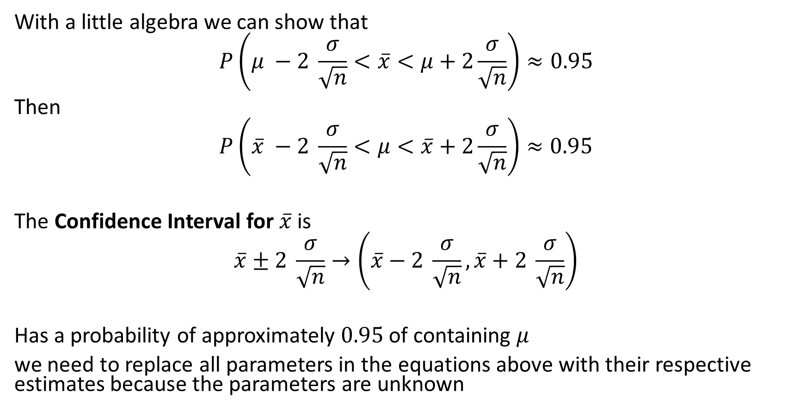

Confidence Interval for $\overline{x}$
With a little algebra we can show that
$$P\left(μ −2 \frac{σ}{\sqrt{n}}<\overline{x}<μ+2\frac{σ}{\sqrt{n}}\right)≈0.95$$
Then
$$P\left(\overline{x} −2 \frac{σ}{\sqrt{n}}<μ<\overline{x}+2\frac{σ}{\sqrt{n}}\right)≈0.95$$
The Confidence Interval for $\overline{x}$ is
$$\overline{x}±2 \frac{σ}{\sqrt{n}}→\left(\overline{x}−2 \frac{σ}{\sqrt{n}},\overline{x}+2 \frac{σ}{\sqrt{n}}\right)$$
Has a probability of approximately $0.95$ of containing $μ$
we need to replace all parameters in the equations above with their respective estimates because the parameters are unknown

Slide 11
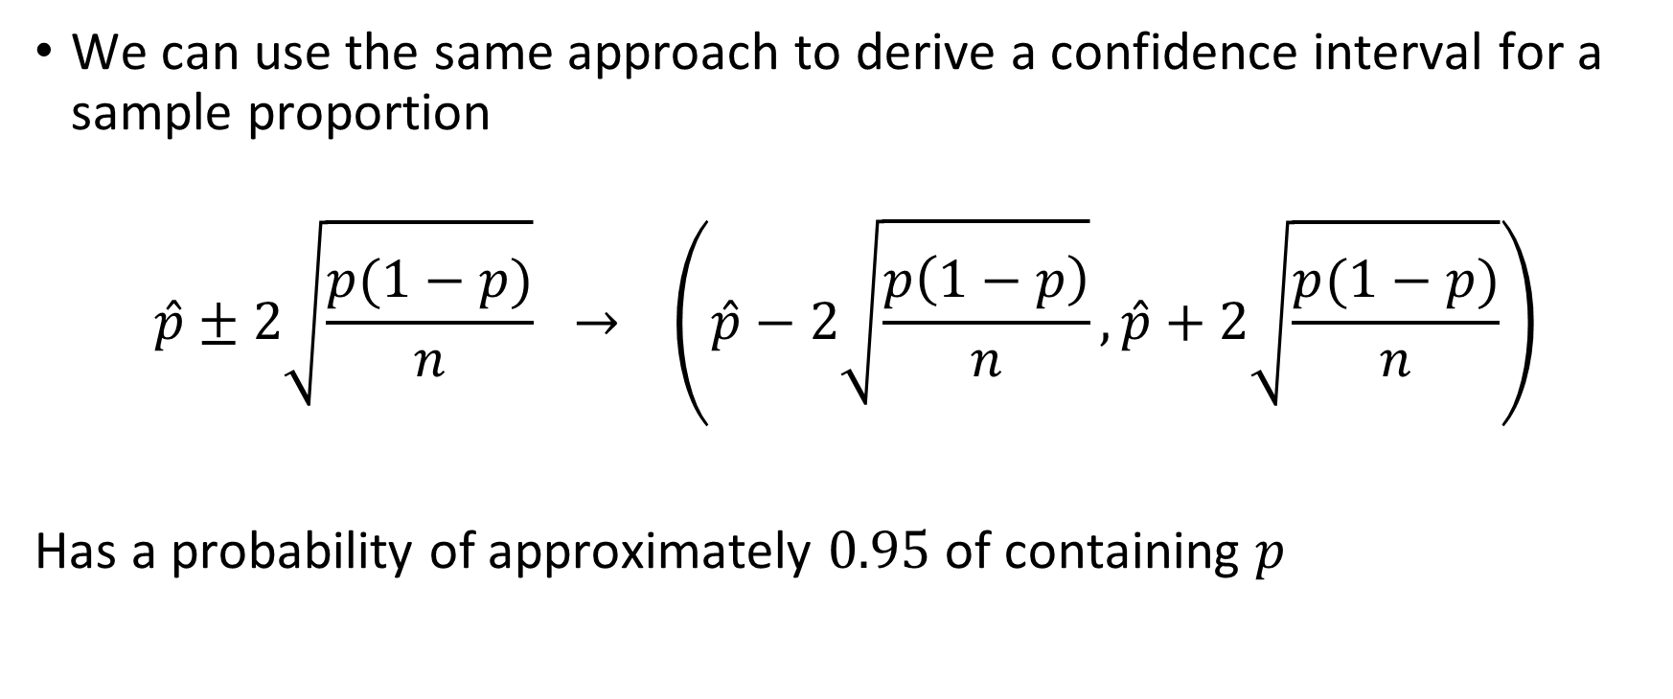

Confidence Interval for $\hat{p}$
We can use the same approach to derive a confidence interval for a sample proportion
$$\hat{p}±2\sqrt{\frac{p(1−p)}{n}} → \left(\hat{p}−2\sqrt{\frac{p\left(1−p\right)}{n}},\hat{p}+2\sqrt{\frac{p(1−p)}{n}}\right)$$
Has a probability of approximately $0.95$ of containing $p$

Slide 12
Example

Slide 13
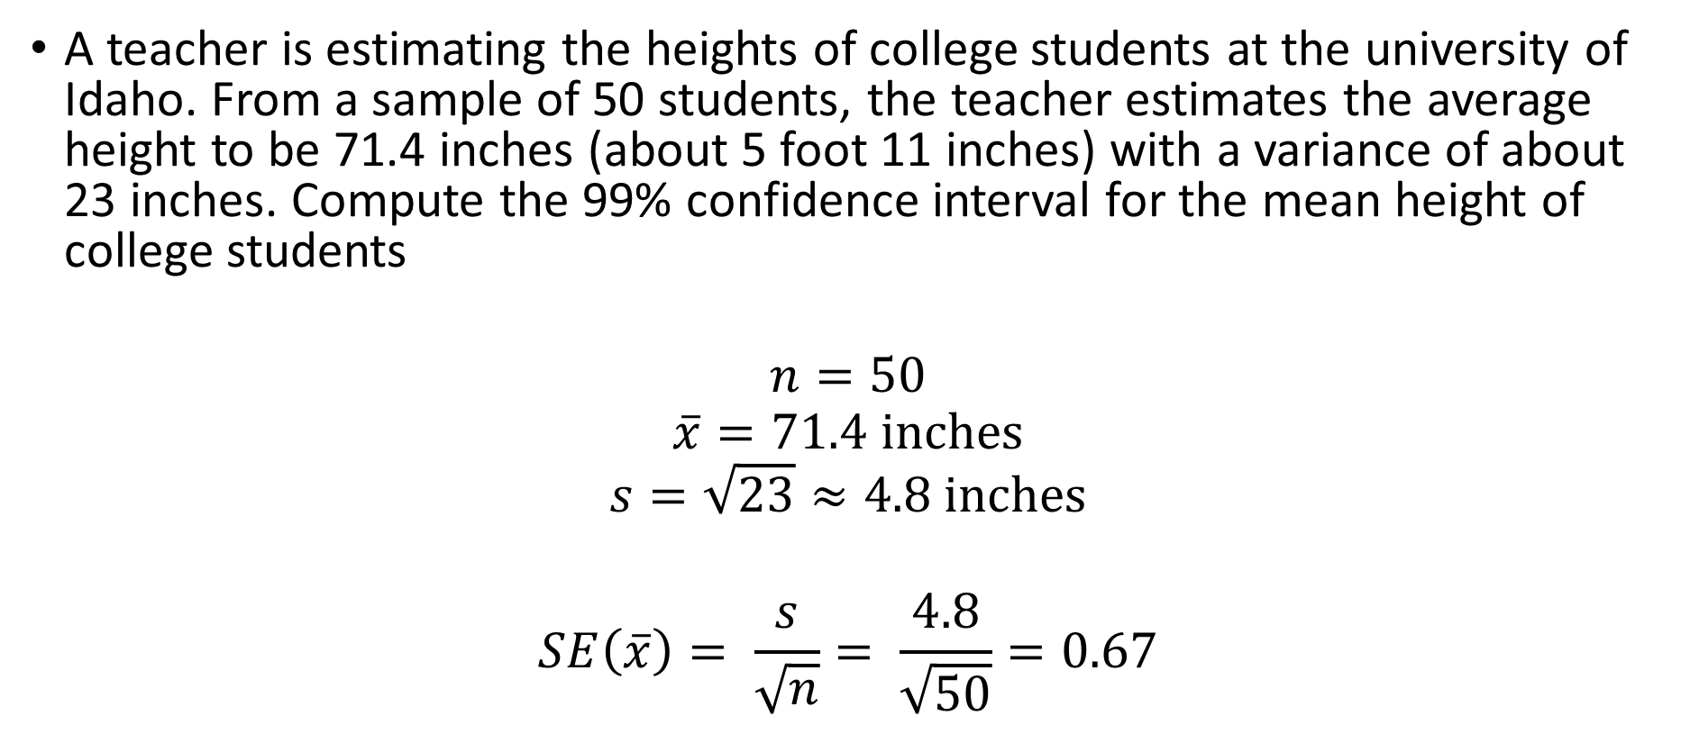

Example: $\overline{x}$
A teacher is estimating the heights of college students at the university of Idaho. From a sample of 50 students, the teacher estimates the average height to be 71.4 inches (about 5 foot 11 inches) with a variance of about 23 inches. Compute the 99% confidence interval for the mean height of college students
$$n=50$$
$$\overline{x}=71.4 inches$$
$$s=\sqrt{23}≈4.8 inches$$
$$SE\left(\overline{x}\right)= \frac{s}{\sqrt{n}}= \frac{4.8}{\sqrt{50}}=0.67$$

